Slide 1
Requirements Management
Agenda:
Big Picture
Current State
Future State
Transition from Project Artifacts to Operational Guidance
SIPOC for Business Analysis (BA)
Note: Customer Needs is a separate discipline that needs to marry up to requirements management. This is a much larger topic and one that is not well understood (let alone put in put in practice).
A separate deck would need to be devoted to outlining this discipline along with the data-driven approach for capturing this information and aligning it with business and domain models.

Slide 2
Requirements (Future State)
Business Needs
Customer Needs
Compliance Needs
Models (Services, Capabilities, Features, Needs)
Continuous Improvement
Models (Rules, Processes, Metrics, Analytics, Metadata)
Rules Engine
BPM Engine
Analytics Engine
Metadata Repository
Architecture (Application, Information, Technical, Operational)
Architecture (Implementation)
Lifecycle Management (Product, Services, Processes, Software, Data, Information)
Ideation
Invention
Evaluation
Execution
Testing
Implementation
Gap Assessment

Slide 3
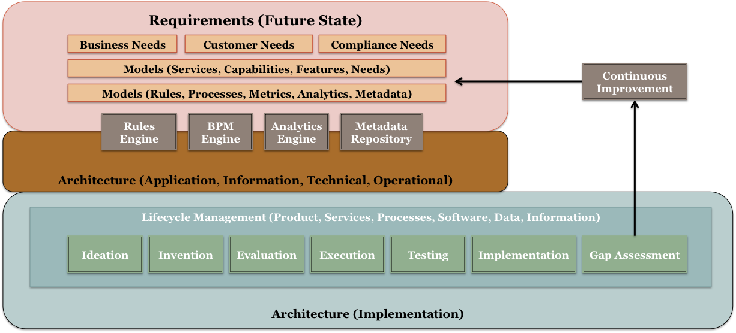
Big Picture
Note: The MDR (metadata repository) contains the taxonomies and ontologies for which all requirements must adhere (semantic mappings support all POVs)

Slide 4
Business Architecture Aligns POV across an organization and between organizations (verticals & horizontals)
WHY
WHAT
Customer Perspective
What a Customer Wants
Strategic Perspective
Customer Perspective
Internal Stakeholder
(X-Functional) Perspective
What an Organization Provides
Investment & Solution
Perspective
Customer Needs
Compliance Needs
Desired Outcomes
Strategy
Value Stream
Initiative
Business
Stakeholder Needs
Value Stream Stage
Capability
Operations Perspective
BU & LOB Perspective
Value (Capability) Gap Perspective
Requirement
Business Entity
Internal
Stakeholder
Product & Service Support
Execution Delivery Perspective
Product & Service Delivery
Product & Service Portfolio
Solution Delivery
Solution Architecture
HOW
Requirements are framed by the strategy they implement, seen through stakeholder value perspective (value stream) and what the business has the ability to do to deliver that value (capability)
Requirements are additionally bound by investment, project and stakeholder focus
Other perspectives for framing, such as product and service, may be exposed using business architecture

Slide 5
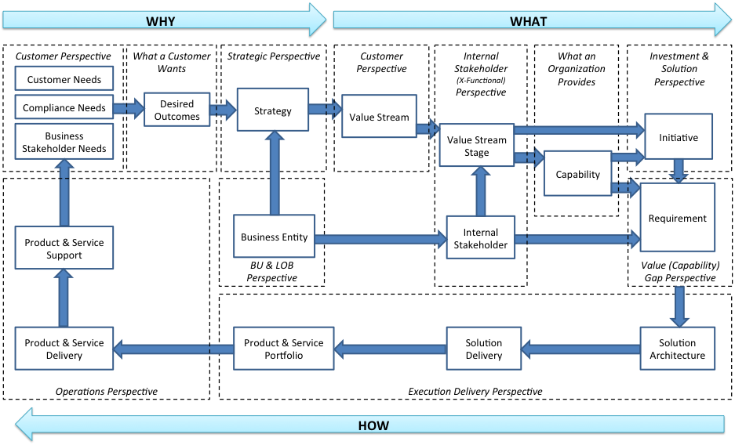
Business Architecture Aligns WHY, WHAT, & HOW across all POVs
Requirements are framed and aligned using business architecture to ensure they address the perspectives (POVs).
When requirements are properly framed, they align strategy and execution to ensure the right value is delivered through the products and services
Business architecture provides a consistent framework for aligning what customers want against what the organization provides as well as driving continuous improvement in value delivery (by closing the right value & capability gaps

Slide 6
Business Architecture Offers Multiple Perspectives on Requirements
Strategic Perspective
Strategy
Investment & Solution
Perspective
Value Stream
Initiative
Value Stream Stage
Capability
Stakeholder Value Perspective
Requirement
Business Unit
What a Business Does
Stakeholder
Organization Perspective
3rd Party & Internal Stakeholder Perspective
Requirements are framed by the strategy they implement, seen through stakeholder value perspective (value stream) and what the business has the ability to do to deliver that value (capability)
Requirements are additionally bound by investment, project and stakeholder focus
Other perspectives for framing, such as product and service, may be exposed using business architecture

Slide 7
Current State
Today requirements are :
drafted as documents
translated into artifacts
decomposed into features
captured in doc objects, spreadsheets, and models
Some challenges include :
subject to interpretation
not easily reused or repurposed
difficult to achieve consistency
quickly becomes irrelevant (shelf-ware)

Slide 8
Future State
Tomorrow requirements could be :
drafted as capabilities and features which are aligned with services (business & infrastructure)
captured as business rules, metadata, metrics, and function points within rules libraries, metadata repository, process models, and analytics models
Some of the benefits may include :
reuse of requirements (all levels of granularity)
high degree of consistency, relevancy, and usability
Requirements become part of the solution (subject to version management & part of configuration mgmt.)

Slide 9
Project Artifacts to Operational Guidance
Metrics are used for verification and validation to ensure quality of projects (across their lifecycle) are used to:
control tolerances for all categories of requirements (all levels of granularity) for products, services, and operations across their lifecycles (while in service)
Success Criteria are acceptable thresholds of performance covering (but not limited to):
projects & test plans (all types of testing)
control charts and certifications
products & services

Slide 10
S–IPO-C
Inputs (BAI)
Processing (BAP)
Outputs (BAO)
1) Sample reports
1) ID Skills / Resources
1) List of Prioritized Features
2) Prototypes
2) Training on Req. Proc/Method.
2) Features by Magnitude
3) Screen Mock-ups
3) Common Document Template
3) ID Depend. & Rel. Impact
4) ID Bus. Problem/Need
4) Publish Glossary
4) List Business of Assumptions
5) What is client trying to solve?
5) ID Req. Workflow
5) Business Process Flow
6) List of prioritized features
6) Statistical Analysis
6) Scope SOW
7) Strategic Product Roadmap
7) Research Tools
7) Bus. Constraints
8) VOC
8) Bus. Rules
9) Non-functional Perf. Req.
9) Traceability Matrix
10) SLR
10) Use Case
11) Bus. Rules
11) Storyboards
12) Bus. Constraint Assumptions
12) Test Scenarios
This is one model for aligning inputs, processes, and outputs for current state business analysis.
A new model would need to be proposed for the future state requirements (as depicted in the “big picture” and subsequent slides above.
13) User Documentation
14) Sample Deliverables
15) Context Diagrams
16) Architectural Diagrams
17) Non-functional Req.
18) Screen Mock Ups
19) Use Case

